Slide 1
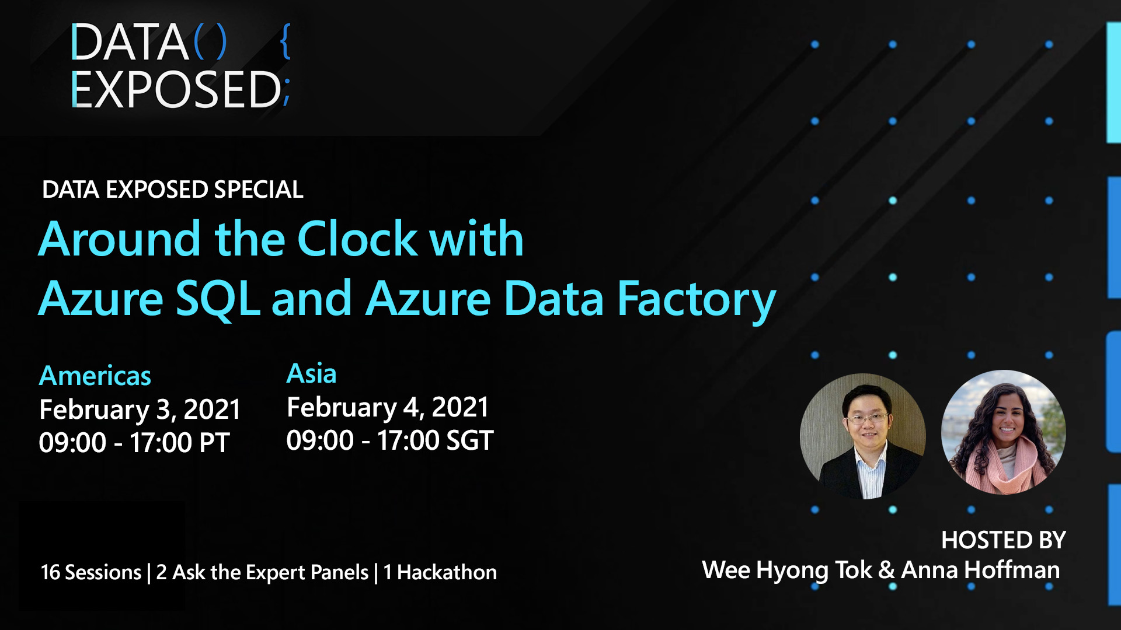

Slide 2

Basic KQL for troubleshooting Azure SQL DB
Julie Koesmarno (@MsSQLGirl)
Program Manager, Microsoft
jukoesma@microsoft.com
Notes:
Agenda:
Overview of KQL and Log Analytics
How to update Diagnostic Setting for SQL Databases
Examples
Recap on Basic KQL syntax
ADS & Kqlmagic - bonus

Slide 3




Kusto Query Language
Optimized query language with visualization options
For fast read-only data retrieval
Troubleshooting & deep diagnostics
Real-time stream / big data analytics
Use KQL to connect and query these Azure Services:
…
Log Analytics
App Insights
Resource Graph
Azure Data Explorer

Slide 4



KQL
KQL Scripts
Azure SQL DB
read data
OR
event log
Notebook with KQL
Executable
Parameterizable (Kqlmagic)
Automatable (Kqlmagic)
Log Analytics
AzureDiagnostics
AzureMetrics

Slide 5
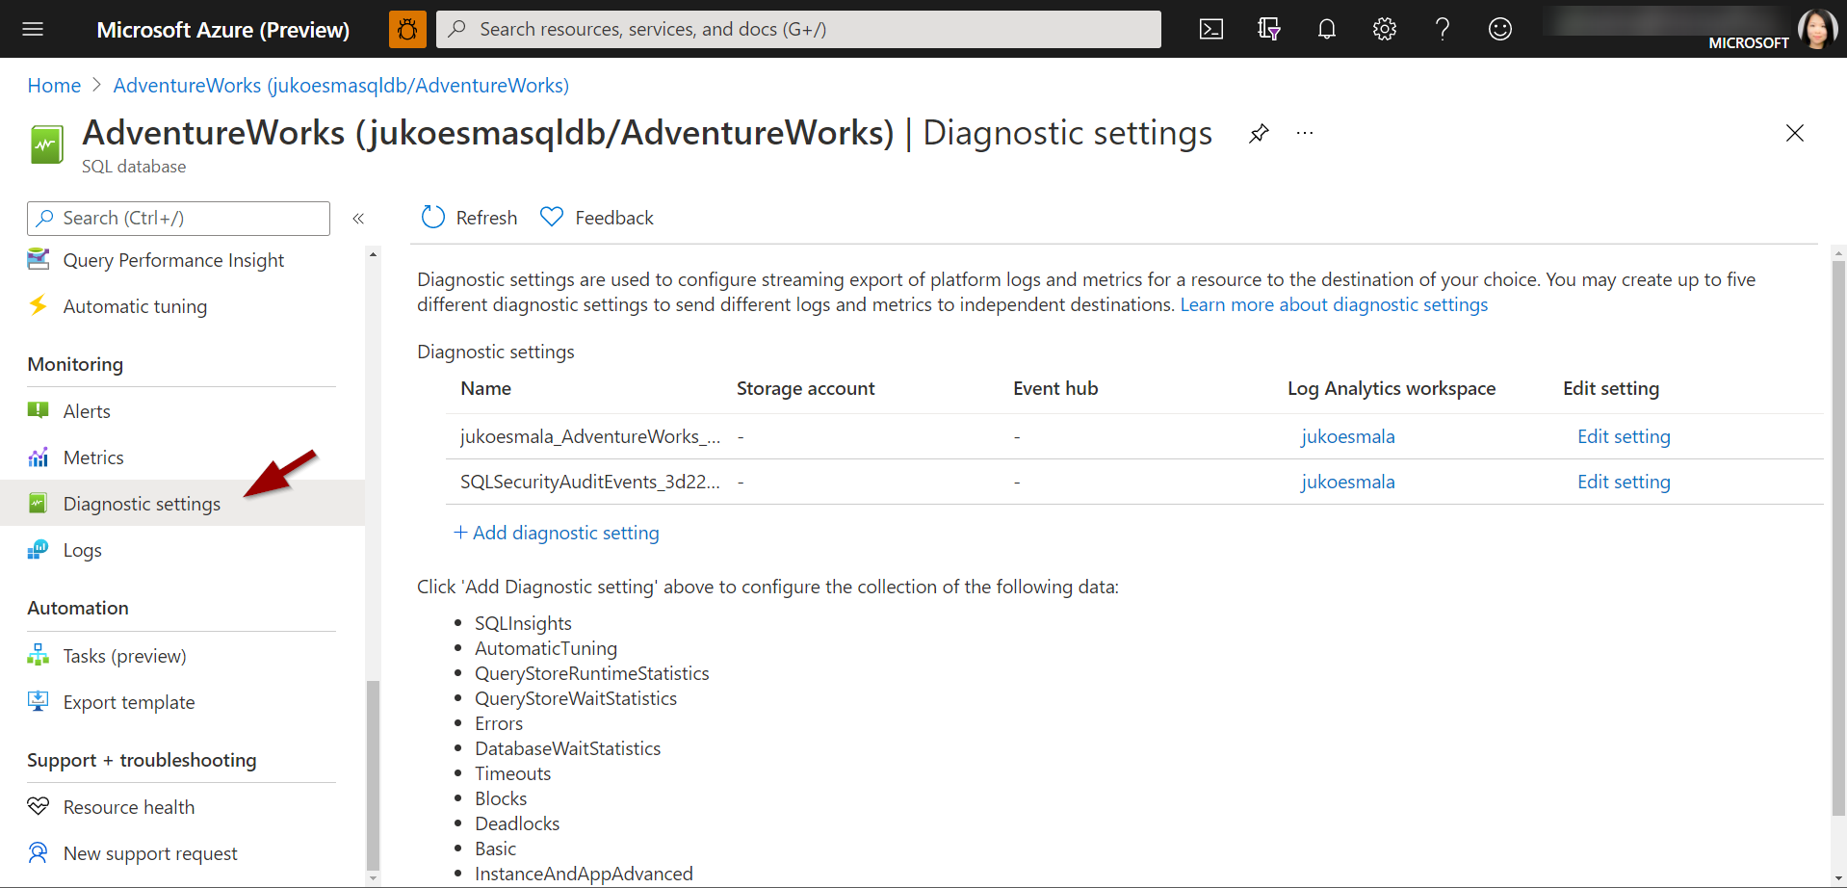
Enabling Diagnostic Settings for Azure SQL databases

Slide 6
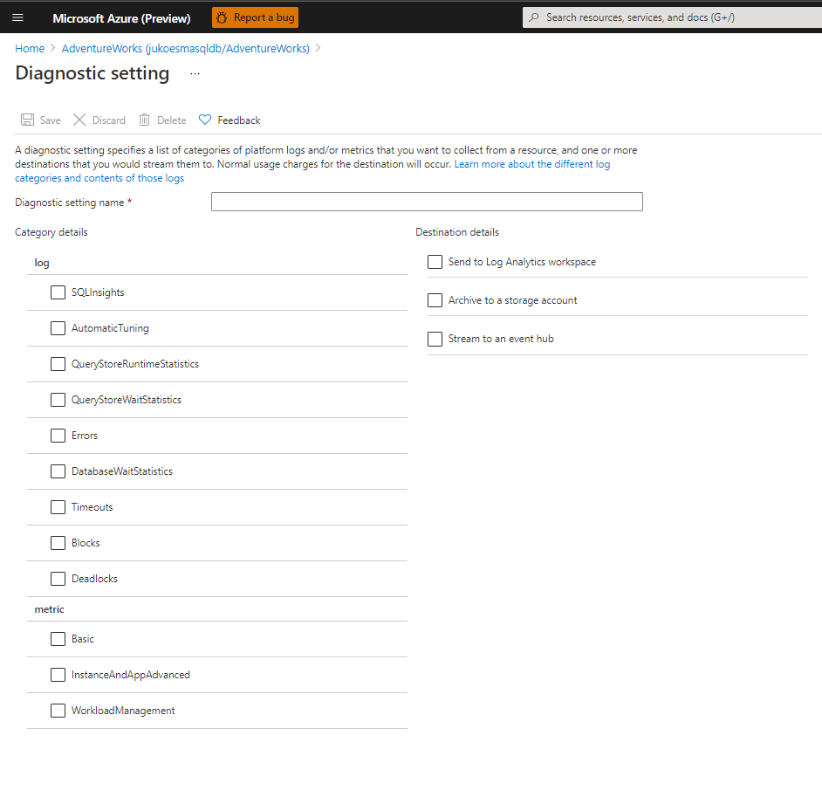
Details you can capture
Category:
Log
Metric
Destination Details:
Send to Log Analytics workspace
Log → AzureDiagnostics
Metric → AzureMetric
Archive to storage account
Stream to an event hub

Slide 7
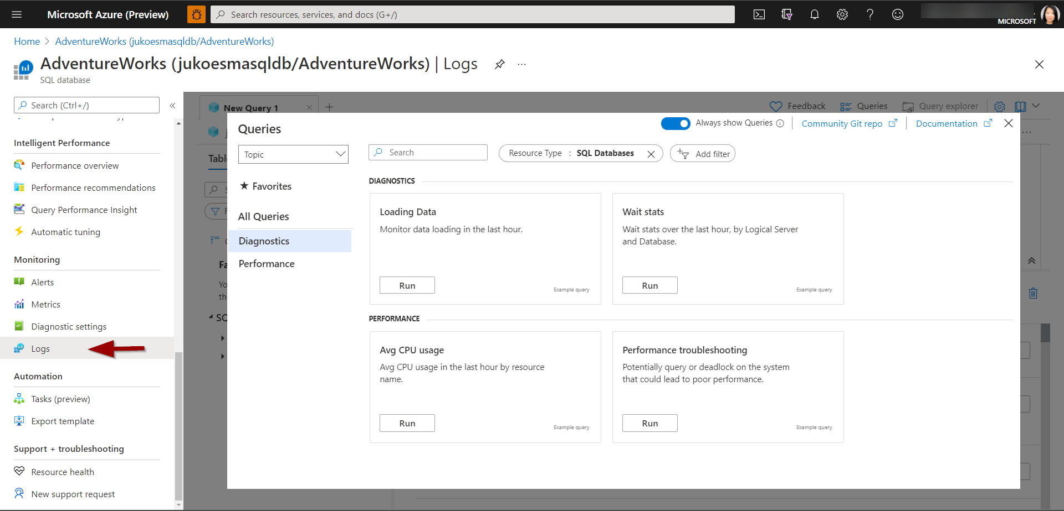
How to access the logs?

Slide 8
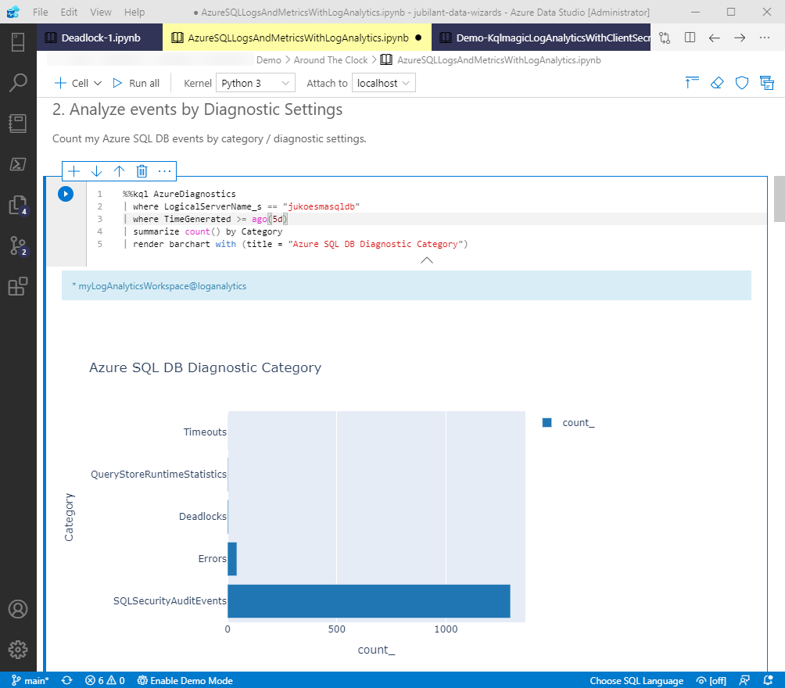
Notebooks
Kernel = Python
Extension = Kqlmagic
Use Case:
Reproducible Analysis
Source control
Troubleshooting guide
Azure SQL DB
read data
event log
Log Analytics

Slide 9
Learning basic KQL part 1
KQL | SQL
AzureDiagnostics | where OperationName == "DeadlockEvent" | project TimeGenerated, Category, Resource, OperationName, Type, deadlock_xml_s | sort by TimeGenerated desc | take 50 | SELECT TOP 50 TimeGenerated, Category, Resource, OperationName, Type, deadlock_xml_s FROM AzureDiagnostics WHERE OperationName = ‘DeadlockEvent’ ORDER BY TimeGenerated DESC
AzureDiagnostics | where action_name_s == ('BATCH COMPLETED') | project TimeGenerated, action_name_s, statement_s | where statement_s contains "DROP TABLE" | take 10 | SELECT TOP 10 TimeGenerated, action_name_s statement_s FROM AzureDiagnostics WHERE OperationName like ‘%DROP TABLE%’

Slide 10
Learning basic KQL part 2
Keywords | Examples
ago | // ago(5d) = DATEADD(DAY, -5, GETDATE()) AzureDiagnotics | where TimeGenerated > ago(5d)
summarize | // Aggregate (GROUP BY) AzureDiagnostics | summarize event_count = count() by OperationName
parse_xml | // Read XML data AzureDiagnostics | where OperationName == "DeadlockEvent" | extend d = parse_xml(deadlock_xml_s)
bin, render | // Bin date/time column, which is handy for timechart viz AzureDiagnostics | where OperationName == "ErrorEvent" | extend ErrorNumber = tostring(error_number_d) | summarize event_count=count() by EventTime = bin(TimeGenerated, 10m), ErrorNumber | render timechart

Slide 11
Learn more
All resources including demo notebook is here:
https://bit.ly/3tgNdMl
Get Azure Data Studio:
http://aka.ms/getAzureDataStudio
Azure SQL DB
read data
event log
Log Analytics

Slide 12
Learn with us! View our on-demand playlist: aka.ms/azuresqlandadf
@AzureSQL
@AzDataFactory

Slide 13
Thank you!

Slide 14
Appendix

Slide 15


Azure Data Studio
Modern data experiences, multi data-platforms SQL: SQL Server, PostgreSQL, Azure SQL Edge, Azure SQL* KQL: Azure Data Explorer Environment: On-premises, poly-cloud
Client tool on multi-platforms: Windows, Linux, macOS
Extensible tool
Git support
Jupyter Notebook experiences
… and more …

Slide 16
Kqlmagic in notebooks
Install Kqlmagic package in Python first via Azure Data Studio “Manage Packages”, or:
!pip install Kqlmagic --no-cache-dir –upgrade
Quick Usage tips:
%reload_ext Kqlmagic is needed on every notebook session
%kql <connection string> is needed at least once on every notebook session. Also use this to add a connection in the session.
%kql or %%kql is needed to be prefixed before any KQL queries
https://docs.microsoft.com/azure/data-explorer/kqlmagic

Slide 17
Connection Tips
The most asked question!
Log Analytics
%kql loganalytics://code;workspace='<WorkspaceID>’
Working with multiple tenants? You can provide Tenant ID in the connection string instead of “code”. For example: %kql loganalytics://tenant=<TenantID>;workspace='<WorkspaceID>'
Fluent in Python? Try out Azure CLI in Python, and use -try-azcli_login option at the end. %kql loganalytics://code;workspace='<WorkspaceID>' -try-azcli_login

Slide 18
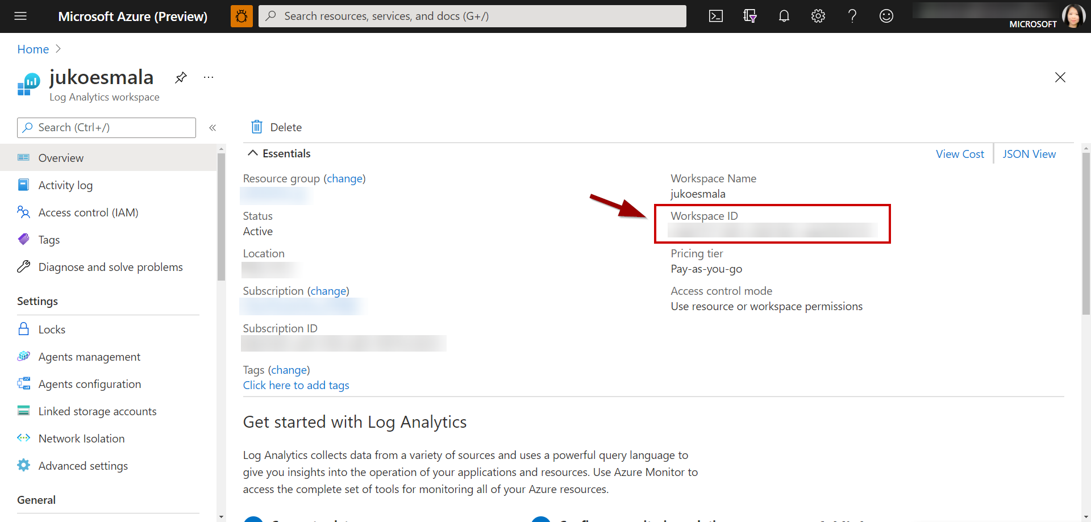
Log Analytics Workspace

Slide 19
Useful commands
Get version %kql --version
Get help on a topic, e.g. connection %kql --help "conn"
Update configuration %env KQLMAGIC_CONFIGURATION="<settings>"
# Set environment variables using %env magic
%env KQLMAGIC_CONFIGURATION="show_query_time=True;plot_package='plotly';display_limit=100"
# use the following to suppress the Kqlmagic banner:
%env KQLMAGIC_CONFIGURATION="show_init_banner=False"

